Slide 1
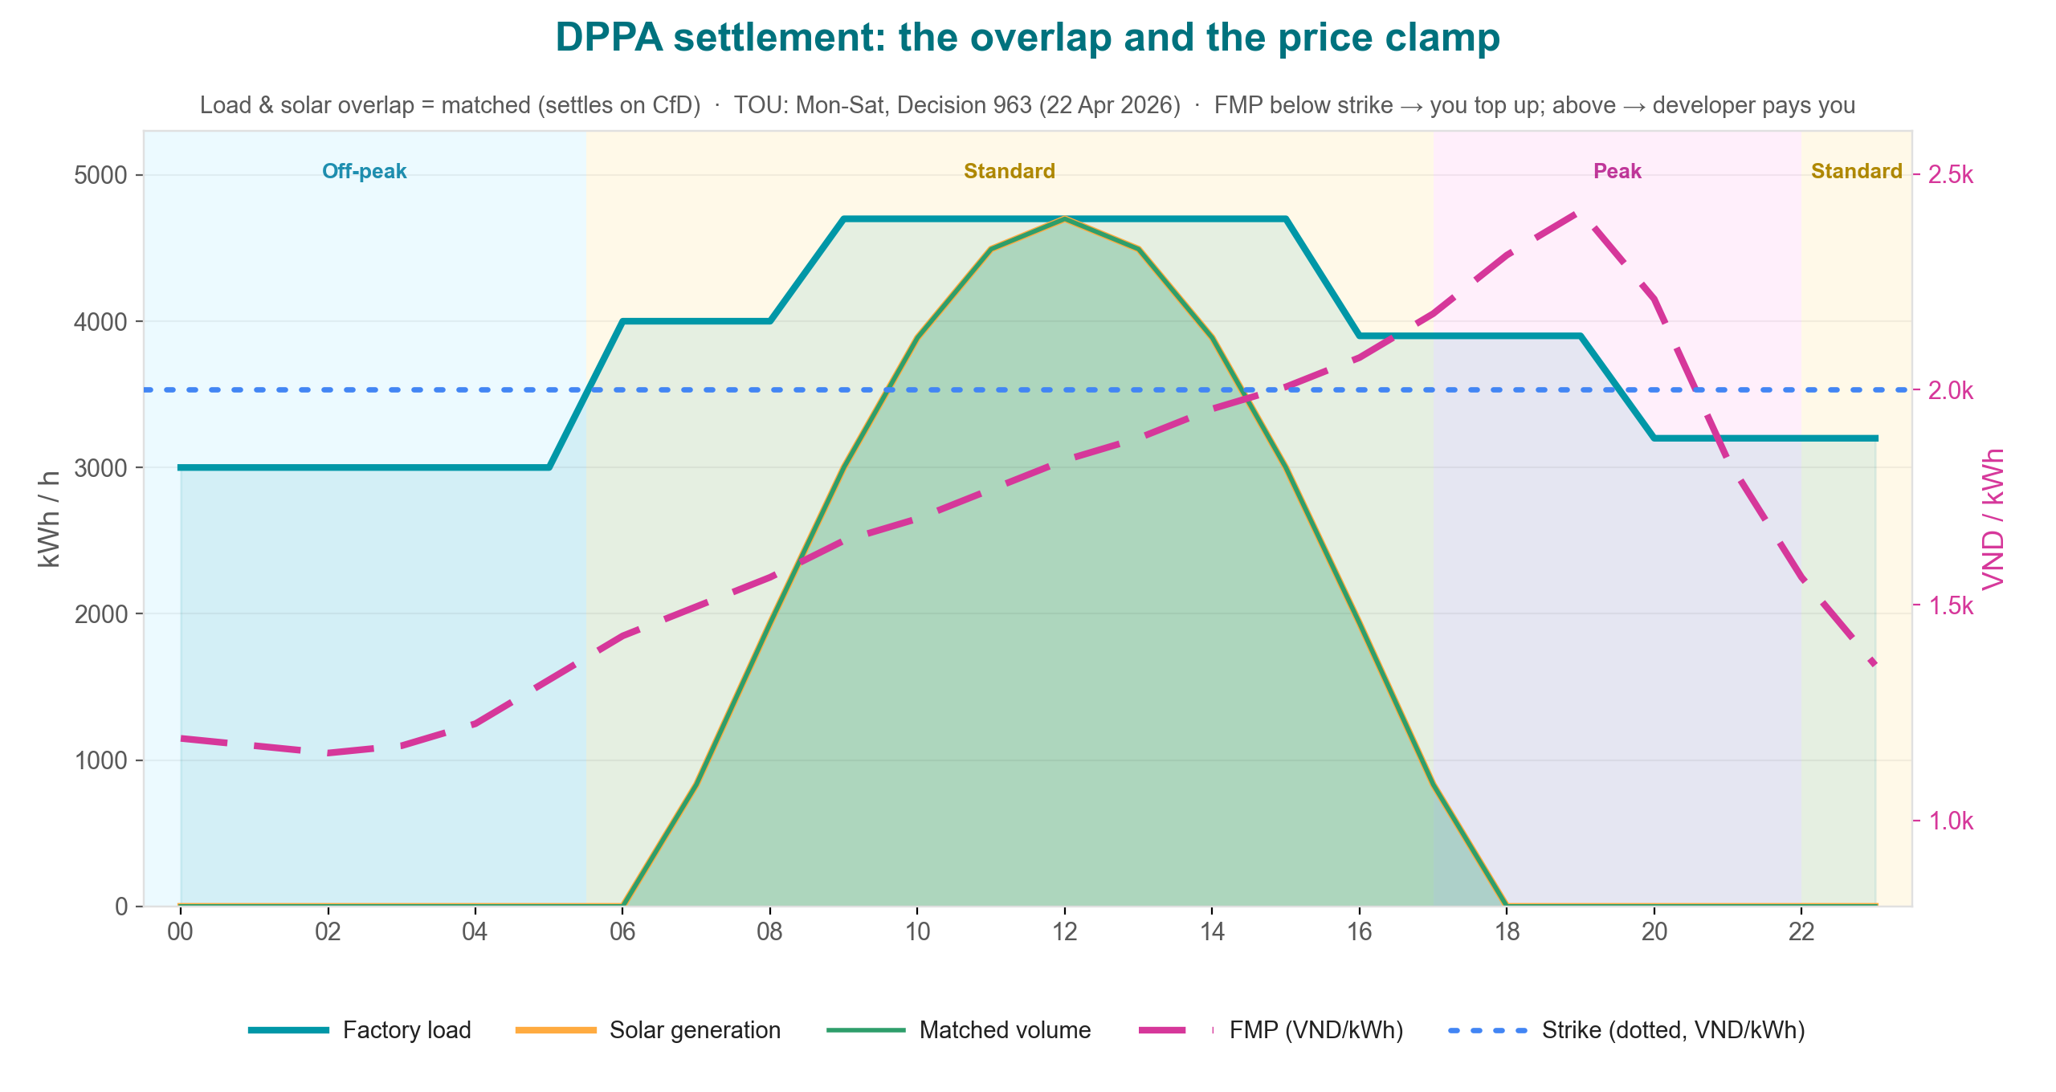
DPPA settlement: the overlap and the price clamp
New TOU bands (Decision 963) + load/solar/matched + FMP vs strike
Illustrative balanced day · strike 2,000 · FMP ~1,700 avg (NSMO/ERAV not public) · mirrors dppa-case.web.app

